Slide 1

Machine Learning (19CSE305)
Term Project: Group 20
Project Title: SENTIMENT ANALYSIS
Department of Computer Science & Engineering,
Amrita School of Engineering, Bengaluru

Slide 2
Agenda
Problem statement & Data Description
Techniques tried and justifications
Results and interpretation
Conclusion

Slide 3
Introduction
Problem statement
When we want to buy something, "What other people think" has always been a significant factor in our decision-making process for most of us. Customers share their thoughts and opinions on a variety of products and services. Customers, however, are unable to read all evaluations due to the large number of them. A lot of research is being done in Sentiment Analysis to answer this problem. Sentiment Analysis is an approach to classifying the sentiments of user reviews, documents, and other sources in terms of positive (good), negative (poor), or neutral (surprise). Most sentiment analysis methods nowadays, provide an overall polarity of the text. However, for fine-grained analysis, it is desirable to comprehend the mood of each aspect of various entities. As a result, we propose a system that uses supervised learning to classify Women’s Clothing E-Commerce Reviews into three categories: positive, negative, and neutral.

Slide 4
Data Description
FEATURE NAME | DATA TYPE | EXPLANATION
CLOTHING ID | INTEGER | UNIQUE IDENTIFICATION NUMBER GIVEN TO EACH PRODUCT
AGE | INTEGER | AGE OF THE CUSTOMER WHO HAS REVIEWED THE PRODUCT
TITLE | VARCHAR | CONCISE DESCRIPTION OF THE REVIEW
REVIEW | VARCHAR | CUSTOMER’S SENTIMENT TOWARDS THE PRODUCT
RATING | INTEGER | VALUE GIVEN OUT OF 5 FOR THE PRODUCT BY THE CUSTOMER
RECOMMENDED IND | INTEGER | PRODUCT RECOMMENDATION AS 0 OR 1 BASED ON THE CUSTOMER REVIEW
POSITIVE FEEDBACK COUNT | INTEGER | COUNT OF THE POSITIVE FEEDBACK FOR THE REVIEW
DIVISION NAME | VARCHAR | DIVISION NAME OF THE PRODUCT
DEPARTMENT NAME | VARCHAR | CATEGORIES OF THE PRODUCT
CLASS NAME | VARCHAR | SUB-CATEGORIES OF THE PRODUCT

Slide 5
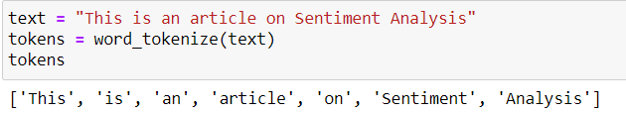
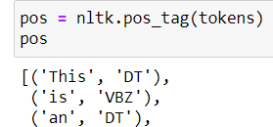
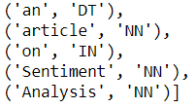
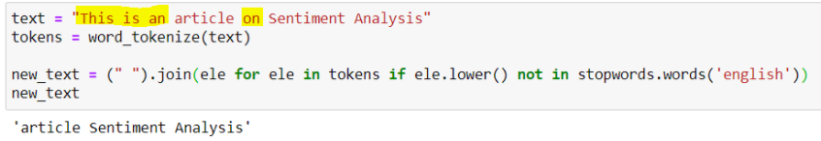

The preprocessing applied is as follows:
Data Cleaning
Tokenization
Creating pos tags
Removing stop-words
Lemmatization

Slide 6
Technique Description
Classifiers used in our project:
Neural Networks
SVM
K-NN
Decision Tree
Logistic Regression
Naïve Bayes
Vader

Slide 7
Results & Discussion
Criteria to select the best classifier for our data:
Size of data : 19662 x 10
Execution time
Linearity
Accuracy
CLASSIFIER | ACCURACY | EXECUTION TIME
NEURAL NETWORK | 0.796 | 0:01:01.54
SVM | 0.814 | 0:01:14.60
K-NN | 0.750 | 0:00:04.31
DECISION TREE | 0.726 | 0:00:04.27
LOGISTIC REGRESSION | 0.811 | 0:00:03.63
NAÏVE BAYES | 0.821 | 0:00:04.27

Slide 8
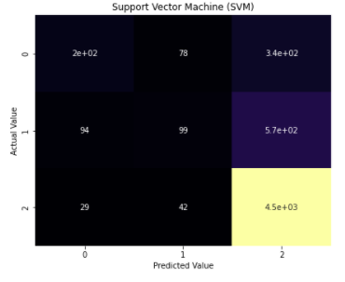
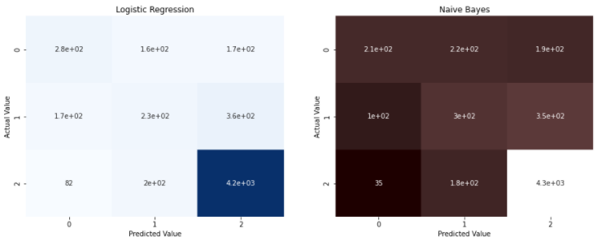
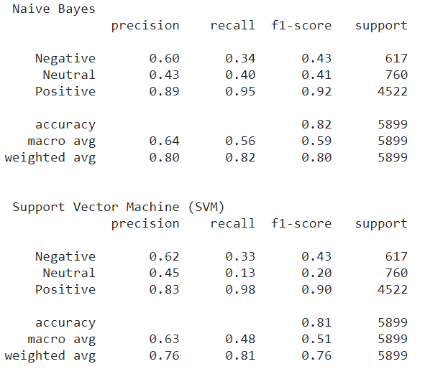
Results & Discussion
Confusion matrices
Precision and recall
F1 score

Slide 9

Thank you !!!!!

